Slide 1


These slides are optimized for Microsoft PowerPoint; viewing with alternative programs like Keynote will cause significant formatting errors.
If you don’t have PowerPoint or encounter issues, we recommend instead using the PDF version available at endpovertyUSA.org.
Based on the book Poverty, by America by Matthew Desmond (Penguin Random House, 2023).
Slides created by Tasneem Yusufali.

Slide 2

We imagine that their sufferings are one thing
and our life another.
© Matthew Desmond, Poverty, by America

Slide 3
1 in 3
get by on $55,000 or less
(108 million)
1 in 9
live below the poverty line
(38 million)
1 in 18
live in deep poverty
(18 million)
© Matthew Desmond, Poverty, by America

Slide 4
CONTENTS
Chapter 1
The Kind of Problem Poverty Is
Chapter 2
Why Haven’t We Made More Progress?
Chapter 3
How We Undercut Workers
Chapter 4
How We Force The Poor to Pay More
Chapter 5
How We Rely on Welfare
Chapter 6
How We Buy Opportunity
Chapter 7
Invest in Ending Poverty
Chapter 8
Empower the Poor
Chapter 9
Tear Down the Walls
© Matthew Desmond, Poverty, by America

Slide 5

Chapter 1:
THE KIND OF PROBLEM POVERTY IS
© Matthew Desmond, Poverty, by America

Slide 6
Poverty isn't a LINE. It's a TIGHT KNOT of social maladies.
© Matthew Desmond, Poverty, by America

Slide 7









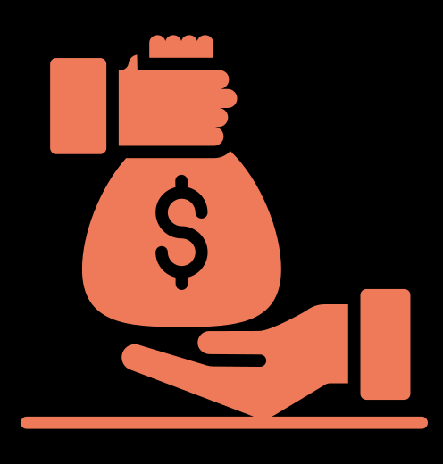



Poverty isn't a LINE. It's a TIGHT KNOT of social maladies.
38% of
impoverished kids
witness shootings;
8% above poverty do.
$22.4 BILLION
The poorest 1% live
12.3 YEARS LESS
than the richest 1%
64%
2.2 MILLION
in jail lived in
poverty
pre-imprisonment
58.5%
people in prison
paid by the poor in
fines and fees yearly
of bankruptcies are
due to medical bills
Federal minimum
wage stuck at
90%
30 MILLION
3.6 MILLION
Cost deters 89% of
people with addiction
from seeking treatment
$7.25
surge in homeless
public-school
students
since 2008
uninsured even
after the ACA
eviction filings
each year
2.5 MILLION
since
children enrolled in
districts without libraries
2009
45 MILLION
Black households face
150% below federal
poverty line?
HALF
600,000
Due to cost,
cannot access
traditional
loans
DOUBLE
of all new jobs
eliminated
within first year
24%
people homeless
each night
the poverty rate of
white households
in poverty skip
medication
15X higher chance of
felony charge
Moms lacking high school
diplomas face up to
5.3 MILLION
Most poor renters
spend over
36%
The U.S. is short
Gun death risk is
2X
$
7 MILLION
infant mortality vs.
college degree-holders
live on less than
50%
of workers are in
the gig economy
20X
$4 PER DAY
of income on housing
affordable rentals
higher in poorest areas
Sources on the reference slide at the end of this chapter.
© Matthew Desmond, Poverty, by America

Slide 8



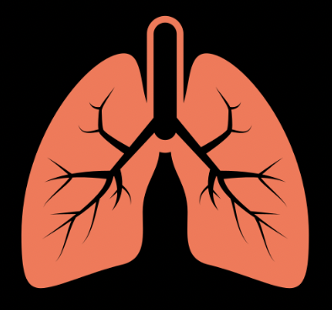





Poverty is PAIN
Poverty is INSTABILITY
Each month, workers at meat plants
sustain an average of 17 severe injuries
The government only provides housing
assistance to 1 in 4 families who need it.
Ref. 1
Page 15
Children in low-income families suffer
a greater prevalence of asthma.
Income volatility, marked by short-term fluctuations in paycheck sizes, has doubled since 1970.
Page 14
Page 16
$
1 in 4 children living in poverty
suffer from untreated cavities.
1 in 4 poor renting families spend more
than 70% of their income on housing costs.
Page 14
Page 15
8 in 10 gunshot victims nationwide
survive the attack, often forced to
live out their days in pain.
Each year, Americans face over 3.6 million eviction filings, a number akin to the foreclosure highs of 2010.
Page 14
Page 15
© Matthew Desmond, Poverty, by America

Slide 9




Poverty is THE LOSS OF LIBERTY
Through a process known as civil asset forfeiture, the U.S. government
seized over $2 billion in cars, homes, and other valuables between
2001 and 2013 from people not charged with any crime.
Page 18
Around 2.2 million people sit in our prisons and jails each day. Another 4.5 million
are on probation or parole. The overwhelming majority of America’s prisoners are very poor.
Page 18
Poverty measures omit the millions in prisons, jails, psychiatric hospitals,
halfway houses, and shelters, understating the true number of poor Americans.
Page 19
© Matthew Desmond, Poverty, by America

Slide 10


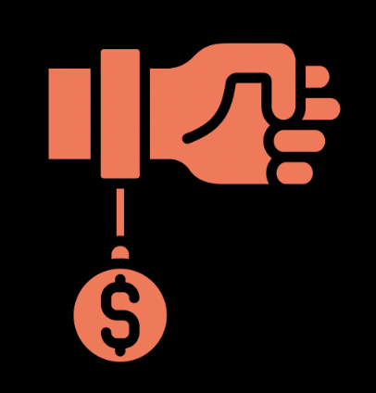


Poverty is FEELING THREATENED BY YOUR GOVERNMENT
Municipal regulations empower the police to arrest the homeless for being seen in
public, criminalizing abject poverty.
Page 19
The poor disproportionately incur costs from the state for minor offenses
like turnstile jumping or carrying a joint.
Page 20
Minor violations trap the poor in a cycle of escalating sanctions and debt,
where they may face jail not for crimes, but for missed payments or inability to afford bail—the modern equivalent of a debtors' prison.
Page 20
1 in 12 people killed by a gun in the United States is killed by a police officer.
3 in 4 Black mothers worry that their children will be brutalized by the police.
Page 19
© Matthew Desmond, Poverty, by America

Slide 11




Poverty is DIMINISHED LIFE AND PERSONHOOD
Poverty changes how you think and prevents you from realizing your full potential.
It shrinks the mental energy you can dedicate to decisions, forcing you to focus on the latest stressor—an overdue gas bill, a lost job—at the expense of everything else.
THE BANDWIDTH TAX
Being poor reduces a person’s
cognitive capacity more than
going a full night without sleep.
The toll taken on the mental capacity of those
affected by economic or other types of scarcity
Page 21
Page 22
When someone is shot dead, the children
who live on that block perform much
worse on cognitive tests in the days
following the murder.
Page 21
© Matthew Desmond, Poverty, by America

Slide 12

HOW THE GOVERNMENT MEASURES POVERTY
The Census Bureau releases two poverty measures every year that describe who is poor in the U.S.
THE OFFICIAL POVERTY MEASURE
THE SUPPLEMENTAL POVERTY MEASURE
Page 10
What’s the
threshold?
3X the cost of a minimal
food budget
The cost of food, clothing, shelter, utilities,
and telecommunications + an extra 20%
Only cash: Salary, child
support, Social Security & unemployment insurance
Adds cash + non-cash benefits like SNAP, free
lunches, subsidies, and tax credits;
Subtracts expenses like taxes and medical bills
What counts as
income?
Differs by family size.
2022 poverty line for a
family of 4: $29.6K
Also adjusts for location, cost of living, and
whether a renter or a homeowner;
Threshold changes throughout the country
How is it
customized?
© Matthew Desmond, Poverty, by America

Slide 13

HOW THE GOVERNMENT MEASURES POVERTY
The Census Bureau releases two poverty measures every year that describe who is poor in the U.S.
THE SUPPLEMENTAL
POVERTY MEASURE
2022 SPM threshold for a
renting family of 4:
$34.5K
15.1%
14.5%
11.7%
10.5%
THE OFFICIAL
POVERTY MEASURE
2022 OPM threshold for
a family of 4:
$29.6K
‘09
'10
'11
'12
'13
'14
'15
'16
'17
'18
‘19
U.S. Census Bureau, Current Population Survey, 2010 to 2020 Annual Social and Economic Supplements (CPS ASEC).
© Matthew Desmond, Poverty, by America

Slide 14


THE RACIAL WEALTH DIVIDE
has more wealth than
$188K
The average white household
headed by someone with a
high school diploma
the average Black household
headed by someone with a
university degree.
Page 23
$36K
To be a poor man is hard, but to be a poor race in a land of dollars is the very bottom of hardships.
$24K
White
Hispanic
Black
Median household net worth
© Matthew Desmond, Poverty, by America

Slide 15
RACIAL INEQUALITY UNDER THE POVERTY LINE
Black and Hispanic people are disproportionally represented among those in poverty.
Disproportionately represented in poverty
Black
1.8
Hispanic
1.5
Asian
0.7
White
0.7
Hispanic children are 22% of the U.S.
but 32.8% of its impoverished children.
Ref. 3
WOMEN
Black women are 12.8% of the U.S.
but 22.3% of its impoverished women.
CHILDREN
Ref. 2
% in
poverty
41.7%
22.3%
27.1%
30.9%
27.3%
32.8%
% of
population
59.9%
12.8%
18.1%
52.5%
14.4%
22.0%
© Matthew Desmond, Poverty, by America

Slide 16
INTERNATIONAL POVERTY RATES
The U.S. has the 10th
highest poverty rate
among 38 OECD countries
Ref. 3
The Organisation for Economic Co-operation
and Development:
A forum with high-
income member
countries
10%
15%
20%
© Matthew Desmond, Poverty, by America

Slide 17



Crystal’s story
Pages 11-13
Age 0
Childhood
Premature Birth Following Violence
Sexual Abuse and Neglect
Crystal was born prematurely
after her mother was attacked,
beginning her life in a volatile
and unsafe environment.
She experienced sexual abuse and
neglect, further aggravating her
emotional and psychological trauma.
Early Childhood
Age 5 Onward
Exposure to Domestic Violence &
Substance Abuse
Multiple Foster Homes
Crystal was placed in foster care,
introducing her to a life of constant
change and uncertainty, and often
lacking emotional support and stability.
Growing up in a household marked by domestic
violence and drug use, Crystal was exposed to severe instability and emotional turmoil from a young age.
© Matthew Desmond, Poverty, by America

Slide 18




Crystal’s story
Pages 11-13
Adolescence
Early Adulthood
Behavioral Issues and Assault Charges
Housing Challenges and Eviction
Conflict with other girls while
living in group homes led to fights
and assault charges for Crystal.
Faced with an assault charge that barred her from
low-income housing and enduring her first eviction,
Crystal struggled to secure stable and affordable housing.
Teens
Adulthood
Deteriorating Health and Support Systems
Loss of SSI Benefits & Homelessness
At 16, Crystal stopped going to school. Her unstable life with numerous
foster homes led to comfort eating and sleep apnea.
She was diagnosed with bipolar disorder, post-traumatic stress disorder,
reactive attachment disorder, and borderline intellectual functioning.
As an adult, Crystal was no longer eligible for Supplemental Security Income. Without this
critical financial lifeline, she was pushed further
into poverty and, eventually, homelessness.
© Matthew Desmond, Poverty, by America

Slide 19
Crystal’s story
Pages 11-13
Adolescence
Early Adulthood
Behavioral Issues and Assault Charges
Housing Challenges and Eviction
Conflict with other girls while
living in group homes led to fights
and assault charges for Crystal.
Faced with an assault charge that barred her from
low-income housing and enduring her first eviction,
Crystal struggled to secure stable and affordable housing.
WHAT DOES CRYSTAL’S STORY TEACH US ABOUT WHAT POVERTY IS?
Teens
Adulthood
Deteriorating Health and Support Systems
Loss of SSI Benefits & Homelessness
At 16, Crystal stopped going to school. Her unstable life with numerous
foster homes led to comfort eating, weight gain, and sleep apnea.
She was diagnosed with bipolar disorder, post-traumatic stress disorder,
reactive attachment disorder, and borderline intellectual functioning.
As an adult, Crystal was no longer eligible for Supplemental Security Income. Without this
critical financial lifeline, she was pushed further
into poverty and homelessness.
© Matthew Desmond, Poverty, by America

Slide 20

Reflect & Discuss
Chapter 1: The Kind of Problem Poverty Is
What is poverty? How can we define it beyond just looking at income?
1.
How do you think race worsens the impact of poverty? How can people and communities
tackle these long-standing inequalities?
2.
How does the exclusion of people in jails, psychiatric wards, and homeless shelters from
poverty statistics affect your perception of the true scope of poverty?
3.
© Matthew Desmond, Poverty, by America

Slide 21
Reflect & Discuss
Chapter 1: The Kind of Problem Poverty Is
How do you think poverty affects children whose families have been poor for many
generations?
4.
How does poverty influence people's self-esteem, self-worth, and their overall sense of identity
and belonging within society?
5.
If poverty is a "relentless piling on of problems,” how does it affect an individual's daily life and
mental well-being? How does the day of a financially-stable person look different from the day
of a person living in poverty?
6.
© Matthew Desmond, Poverty, by America

Slide 22
REFERENCES
Chapter 1
2.2 million people in prison
38% of impoverished kids witness shootings
$22.4 billion paid by the poor in fines and fees: Page 73
The poorest 1% live 12.3 years less that the top 1%
64% in jail lived in poverty pre-imprisonment
66.5% of bankruptcies are due to medical bills
Cost deters 89% with addiction from seeking treatment
The federal minimum wage hasn’t changed since 2009
90% more homeless students since 2008
30 million uninsured
3.6 million eviction filings each year: Page 15
2.5 million children enrolled in districts without libraries
600K people homeless each night
45 million cannot access traditional loans
Black households face double the poverty rate of white: Page 22
15X higher likelihood of felony charge for those in poverty
Half of all new jobs eliminated within the first year: Page 16
Due to cost, 24% in poverty skip medication
Higher infant mortality rate for less educated mothers
5.3 million living on less that $4 per day: Page 18
Most poor renters spend over 50% income on housing: Page 15
36% of workers are in the gig economy
The U.S. is short 7 million affordable rentals
Gun death risk is 20X higher in poorest areas
© Matthew Desmond, Poverty, by America

Slide 23
REFERENCES
Chapter 1
Wasley, Andrew. “Two Amputations a Week: The Cost of Working in a US Meat Plant.” The Guardian, July 17, 2018. https://www.theguardian.com/environment/2018/jul/05/amputations-serious-injuries-us-meat-industry-plant.
U.S. Census Bureau. “Inequalities Persist despite Decline in Poverty for All Major Race and Hispanic Origin Groups.” Census.gov,
December 9, 2021. https://www.census.gov/library/stories/2020/09/poverty-rates-for-blacks-and-hispanics-reached-historic-lows-in-2019.html.
“The Basic Facts About Women in Poverty.” Center for American Progress, 3 Dec. 2021, www.americanprogress.org/article/basic-facts-women-poverty.
Statista. “Poverty Rates in OECD Countries 2022 | Statista,” January 8, 2024. https://www.statista.com/statistics/233910/poverty-rates-in-oecd-countries/.
Select icons in this chapter are courtesy of The Noun Project.
© Matthew Desmond, Poverty, by America

Slide 24

Chapter 2:
Why Haven’t We Made More Progress?
© Matthew Desmond, Poverty, by America

Slide 25


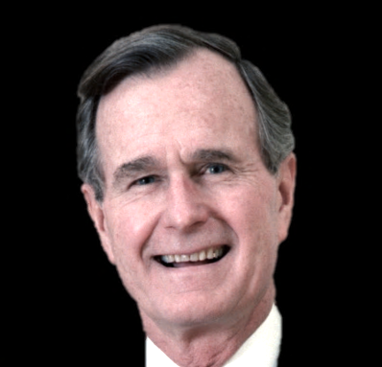




The poverty rate has remained fairly flat in 40 years
Take a guess: Are we now stingier, more generous, or stagnant with antipoverty spending?
Page 27
Supplemental Poverty
Measure
14.6%
11.7%
13%
$ per person on
means-tested
programs:
(2009 dollars)
10.5%
$1,015
Poverty Rate
Aid based on
income and
financial need
1980
2019
© Matthew Desmond, Poverty, by America

Slide 26
The poverty rate has remained fairly flat in 40 years
Antipoverty spending has increased substantially over the last 4 decades.
Page 27
237% increase
$3,419
Supplemental Poverty
Measure
14.6%
11.7%
13%
$ per person on
means-tested
programs:
(2009 dollars)
10.5%
$1,015
Poverty Rate
Aid based on
income and
financial need
1980
2019
© Matthew Desmond, Poverty, by America

Slide 27



spending more to stay in the same place
The past success of antipoverty spending hinged on robust unions;
their decline now undermines antipoverty effectiveness.
GREAT SOCIETY & WAR ON POVERTY
Union Density
(% workers in unions)
Transformative programs aimed at eradicating poverty nationwide
Antipoverty Spending
Union
Power
Medicare & Medicaid
Act of 1965
Food Stamp
Act of 1964
Poverty
Poverty Rate
$
Economic Opportunity
Act of 1964
Page 137
Job Corps
Head Start
1960
2020
© Matthew Desmond, Poverty, by America

Slide 28





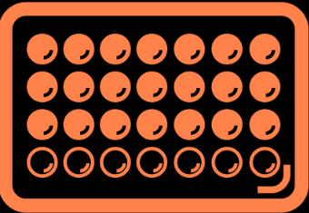
Why haven’t we made more progress?
IMMIGRATION?
SINGLE PARENTHOOD?
Page 34
In the last half century, the states with the most
immigration have unchanged or reduced poverty.
Single parents in the United States fare much
worse than those in other rich countries.
The U.S. falls behind other wealthy countries in:
California
Texas
Florida
0.7%
5.2%
3.7%
Paid Parental
Leave
Minimum Wage Standards
Affordable
Childcare
Reproductive
Health Choices
1970
2019
1970
2019
1970
2019
The U.S. ranks 4th in single-parent household
poverty among 35 OECD nations.
Immigration Rate (%)
Poverty Rate (%)
Page 36
© Matthew Desmond, Poverty, by America

Slide 29




Why haven’t we made more progress?
The US welfare system is a leaky bucket.
TANF
In 2020, for every TANF dollar budgeted,
only 22 cents directly reached poor families.
Temporary Assistance for Needy
Families: A federal cash welfare
program for low-income households
Pages 28-29
$36.1
billion instead
spent on:
$7.1 billion in
direct cash to
poor families
$
In 2021, state governments
held around $6 billion
in unspent welfare funds.
Work training
Marriage counseling
Abstinence-only sex education
Anti-abortion pregnancy centers
Private school
Fitness camps
Anti-drug classes
In 1996, Bill Clinton transformed welfare into
a block grant that gave
states considerable
freedom in deciding how
to distribute the money.
Page 30
cbpp.org: Search “TANF” to learn more
© Matthew Desmond, Poverty, by America

Slide 30







The MYTH of THE “SUCCESS SEQUENCE”
Young people are advised to avoid poverty in America through three steps, but it’s not so simple.
Childcare costs prevent single
parents from full-time employment.
3.
Black Americans who followed
the success sequence were
less likely to escape poverty
than whites who did the same.
Have children
after marriage
2.
Obtain a
full-time job
The step responsible for
nearly all the “success” is securing a full-time job.
1.
There are more poor people who followed all three rules than
there are who broke all three.
Graduate from
high school
Page 36
© Matthew Desmond, Poverty, by America

Slide 31
Reflect & Discuss
Chapter 2: Why Haven’t We Made More Progress?
Considering the increase in anti-poverty spending in recent decades, what are
the systemic issues that prevent this financial aid from effectively reducing poverty? What is
behind our lack of progress?
1.
Reflect on the distribution of TANF funds for non-essential programs. What does this reveal
about the priorities of state governments, and how does it impact the fight against poverty?
2.
Given the advancements in medicine and technology, why do you think welfare benefits haven't significantly alleviated poverty? Does progress in one sector automatically translate to progress
in social issues like poverty?
3.
© Matthew Desmond, Poverty, by America

Slide 32
Reflect & Discuss
Chapter 2: Why Haven’t We Made More Progress?
What misconceptions about immigrants and poverty in the United States does the chapter
address? How do these misconceptions hinder progress in combating poverty?
4.
Reflecting on your own community, can you identify examples where government aid might
not be directly reaching those in need?
5.
The notion that single parenthood leads to poverty is challenged by international comparisons.
What factors might explain the unique situation in the United States, and how should policy respond?
6.
© Matthew Desmond, Poverty, by America

Slide 33

Chapter 3:
How we undercut workers
© Matthew Desmond, Poverty, by America

Slide 34
How we undercut workers
What do we deny workers when we deny them
living wages? Happiness, health — life itself.
PRISON WAGES
CEO PAY DISCREPANCY
UNDOCUMENTED
WORKERS
STAGNANT WAGES
Productivity
$25
320X
74.4%
21X avg.
worker pay
$7.25
Hourly pay
9.2%
$0.14
1965
2019
More than a third are paid
below minimum wage
1973
2013
Prison
(avg.)
Livable
Federal
Ref 1
Ref. 2
Ref 3
Ref 4
© Matthew Desmond, Poverty, by America

Slide 35
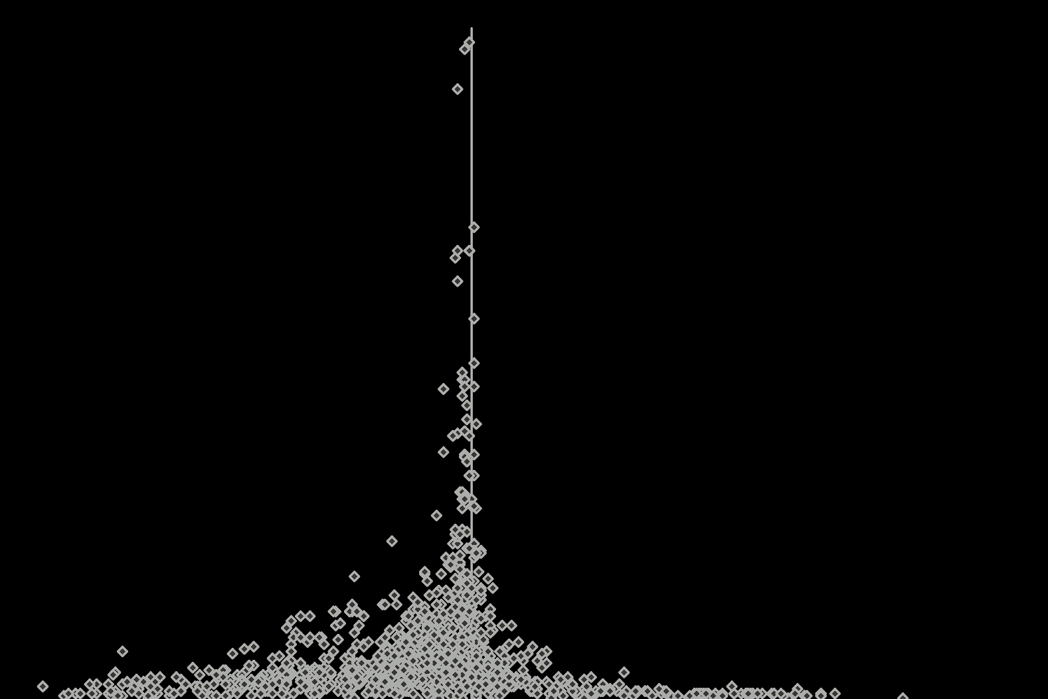


Why aren’t workers earning their worth?
WAGES UP, JOBS DOWN?
GLOBALIZATION? TECH?
Page 52
The best evidence shows that minimum wage
increases have little to no impact on job growth.
Belgium, Canada, Italy, and many other rich countries
haven’t experienced the kind of wage stagnation and
surge in income inequality the US has.
More Precise
Studies
INSUFFICIENT EDUCATION?
Page 51
Less Precise
Studies
The share of poverty jobs has risen even for those with a
college education.
In 2020, a third of workers aged
25-64 with college degrees earned
below the nation’s median income.
Job Loss
Job Growth
no
impact
on jobs
Ref. 5
© Matthew Desmond, Poverty, by America

Slide 36







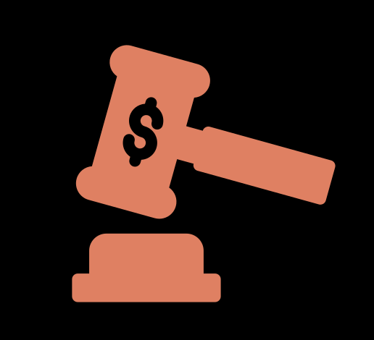
HOW COMPANIES ENGINEER POVERTY
Our grandparents had careers. Our parents had jobs. We complete tasks.
That’s been the story of the American working class and working poor, anyway.
CONTRACT WORK
GIG JOBS
ALGORITHMS
Page 53
Page 54
Ref. 6
Temporary employment without
long-term employer commitments or benefits
Short-term tasks paid per project,
often facilitated by apps
Unpredictable Scheduling
41% of early-career U.S. hourly workers receive schedules with less than a week's notice due to just-in-time scheduling practices
Tech companies save up to
$100K per job each year.
Gig workers are often ineligible for:
Vacation Time
Overtime
Employees endure lower wages
& fewer promotion chances.
Health Insurance
$
Constant Monitoring
Sick Days
Algorithmic monitoring of even
keystrokes and motion can be used to
dock pay for “breaks,” including using
the bathroom.
Minimum Wage
Temp agencies compete over
who can offer cheapest labor.
Worker’s Compensation
© Matthew Desmond, Poverty, by America

Slide 37


HOW COMPANIES ENGINEER POVERTY
Our grandparents had careers. Our parents had jobs. We complete tasks.
That’s been the story of the American working class and working poor, anyway.
UNION BUSTING
LOBBYING
Page 55
Page 56
The efforts by employers to prevent employees from
joining labor unions to protect their rights
Companies influence policymakers to limit labor
protections, often prioritizing profits over well-being
A 2019 report charged 42% of employers with
violating federal law during union campaigns.
1 in 3 cases involved illegal retaliatory firing.
In 2022, Amazon, Meta & Comcast spent
more than all labor unions combined
Employers spent
$433 million
on “union avoidance” consultants in 2021.
$3.5 Billion
$52 million
spent by corporations
spent by unions
opensecrets.org A campaign finance and lobbying database
© Matthew Desmond, Poverty, by America

Slide 38
MILESTONES IN THE U.S. LABOR UNION MOVEMENT
A union is an organization of workers formed to negotiate collectively
with employers over wages, benefits, and working conditions
National Labor Union Founded
PATCO Strike and Firing
Taft-Hartley Act
President Reagan's firing of 11,000
striking air traffic controllers marked a
decline in federal support for unions.
America's first labor federation
pushed for an eight-hour workday
and better conditions.
Curbed union powers and enabled right-
to-work laws, diminishing union influence
1935
1955
2018
1866
1947
1981
Wagner Act
AFL-CIO Merger
Janus v. AFSCME
Legitimized unions and boosted labor
through collective bargaining protections
United diverse labor factions and
amplified their collective negotiating
strength and political impact in the U.S.
Cut public union funds by
ending mandatory fees
from non-members
© Matthew Desmond, Poverty, by America

Slide 39
AFRICAN AMERICANS AND THE LABOR MOVEMENT
Unions' discrimination against Black workers undermined
their own mission to advocate for workers' rights.
Page 48
1949 Red Hand Incident: Union
members in Philadelphia protest
plant integration with racist pamphlets
A 1964 study found that 30% of unions
had policies that discriminated against
minority workers
National Labor Union Founded
PATCO Strike and Firing
Wagner Act
Taft-Hartley Act
AFL-CIO Merger
Janus v. AFSCME
The American Federation of Labor did
not integrate until 1955.
Eugene Debs, leader of the American Railway
Union, fails to get union members to accept
Black railroaders during the Pullman strike
© Matthew Desmond, Poverty, by America

Slide 40
© Matthew Desmond, Poverty, by America
From cures to dialysis
Poverty remains stagnant because today's weakened
unions can’t protect workers like they once did.
29%
Union Density
% workers in unions
22%
18.6%
Poverty Rate
12%
11.7%
Supplemental
Poverty Measure
10.5%
Page 137
1960
1975
1990
2005
2020

Slide 41
Fading Unions and Widening Wage Gaps
Unions’ declining power over 7 decades has led to wage stagnation and growing inequality.
29%
Declining unionization effectively reduced the median
hourly wage by $1.56 from 1979 to 2017,
costing a full-time, year-round worker $3,250 annually.
Income share
of top 1%
Union
Density
19%
Ref. 12
12%
12%
The U.S. has the 5th lowest
union membership rate among
31 OECD countries.
Page 23
1960
2022
Ref. 13
© Matthew Desmond, Poverty, by America

Slide 42

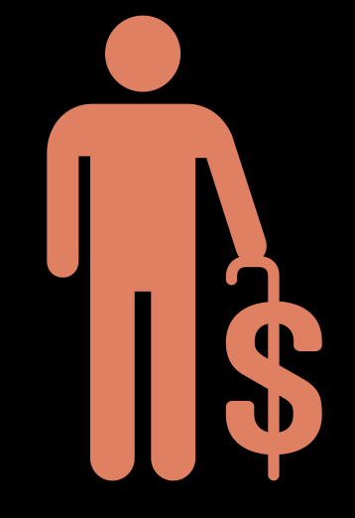



How We All Contribute to exploitation
THE STOCK MARKET
ADDICTION TO CONVENIENCE
Our direct and indirect investments influence labor prices.
Our reliance on certain companies fuels a cycle of
worker exploitation.
WHEN A COMPANY
RAISES WAGES
STOCKS FALL:
Traders punish a
perceived threat to profit
Amazon warehouse
turnover rate:
150%
Vehicle and fuel costs
take 30% of Uber
drivers' earnings.
Through many indirect means, most Americans are SHAREHOLDERS who benefits from low labor costs:
1 in 7 gig workers
earned under the
federal minimum
wage ($7.25).
401(k) retirement
plans
College savings
(529) plans
Amazon workers
had DOUBLE the
serious injury rate of
peers in 2021.
Universities with
large endowments
Bank savings
accounts
Income volatility is a
major reported stressor
for gig workers.
Refs. 7-11
© Matthew Desmond, Poverty, by America

Slide 43

Reflect & Discuss
Chapter 3: How We Undercut Workers
This chapter points out the limited upward mobility and low wages in the U.S. compared to other countries. How does this challenge the narrative of capitalism as a system that rewards hard work
and merit?
1.
Reflect on the power imbalance between corporations and workers mentioned in this chapter.
Can capitalism be reformed to better serve the working poor, or is an alternative economic
system necessary to address these disparities?
2.
Considering the historical context provided in this chapter, can you think of any potential risks
of strong unions that could harm the economy and workforce diversity?
3.
© Matthew Desmond, Poverty, by America

Slide 44
Reflect & Discuss
Chapter 3: How We Undercut Workers
Have you ever benefited from a system or service that you wouldn't personally want to work in
due to its conditions?
4.
How do you relate the shift from "careers" to "tasks" in America with what you've seen in your
personal, familial, or community experiences? And in what ways do dwindling union
memberships touch upon your or your acquaintances' work situations?
5.
How might our daily conveniences like ordering online or hailing a ride, coupled with our
investment strategies, feed into worker exploitation?
6.
© Matthew Desmond, Poverty, by America

Slide 45
REFERENCES
Chapter 3
Initiative, Prison Policy. “How Much Do Incarcerated People Earn in Each State?” Prison Policy Initiative, April 10, 2017. https://www.prisonpolicy.org/blog/2017/04/10/wages/.
Economic Policy Institute. “CEO Compensation Surged 14% in 2019 to $21.3 Million: CEOs Now Earn 320 Times as Much as a Typical Worker,” n.d. https://www.epi.org/publication/ceo-compensation-surged-14-in-2019-to-21-3-million-ceos-now-earn-320-times-as-much-as-a-typical-worker/#:~:text=In%202019%2C%20the%20ratio%20of,in%20the%20top%200.1%25).
Employers Exploit Unauthorized Immigrants to Keep Wages Low - NYTimes.Com,” September 3, 2015. https://www.nytimes.com/roomfordebate/2015/09/03/is-immigration-really-a-problem-in-the-us/employers-exploit-unauthorized-immigrants-to-keep-wages-low.
Economic Policy Institute. “Wage Stagnation in Nine Charts,” n.d. https://www.epi.org/publication/charting-wage-stagnation/.
Stanley, T. D. “Does Economics Add up? An Introduction to Meta-Regression Analysis.” European Journal of Economics and Economic Policies: Intervention 10, no. 2 (September 1, 2013): 207–20. https://doi.org/10.4337/ejeep.2013.02.05.
Brookings. “Do Unpredictable Hours Undermine Upward Mobility? | Brookings,” July 29, 2016. https://www.brookings.edu/articles/do-unpredictable-hours-undermine-upward-mobility/.
© Matthew Desmond, Poverty, by America

Slide 46
REFERENCES
Chapter 3
1
.
.
.
.
.
Segal, Edward. “Amazon Responds to Release of Leaked Documents Showing 150% Annual Employee Turnover.” Forbes, October 24, 2022. https://www.forbes.com/sites/edwardsegal/2022/10/24/amazon-responds-to-release-of-leaked-documents-showing-150-annual-employee-turnover/?sh=744a3a891d0b.
https://fuelandtiresaver.com/wp-content/uploads/2020/03/Zoepf_The-Economics-of-RideHialing_OriginalPdfFeb2018.pdf
Wasley, Andrew. “Two Amputations a Week: The Cost of Working in a US Meat Plant.” The Guardian, July 17, 2018. https://www.theguardian.com/environment/2018/jul/05/amputations-serious-injuries-us-meat-industry-plant.
https://www.apa.org. “Volatile Pay for Gig Workers Linked to Health Problems.” December 8, 2022. https://www.apa.org/news/press/releases/2022/12/volatile-gig-workers-health-problems.
Zipperer, Ben. “National Survey of Gig Workers Paints a Picture of Poor Working Conditions, Low Pay - The Shift Project.” The Shift Project, January 18, 2024. https://shift.hks.harvard.edu/gig-workers-working-conditions/.
“The Enormous Impact of Eroded Collective Bargaining on Wages.” Economic Policy Institute, www.epi.org/publication/eroded-collective-bargaining/#:~:text=Recent%20research%20on%20trends%20in,time%2C%20full%2Dyear%20worker.
Buchholz, Katharina. “How U.S. Trade Union Membership Compares.” Statista Daily Data, 20 Jan. 2023, www.statista.com/chart/9919/the-state-of-the-unions.
Select icons in this chapter are courtesy of The Noun Project.
© Matthew Desmond, Poverty, by America

Slide 47

Chapter 4:
How we force the poor to pay more
© Matthew Desmond, Poverty, by America

Slide 48

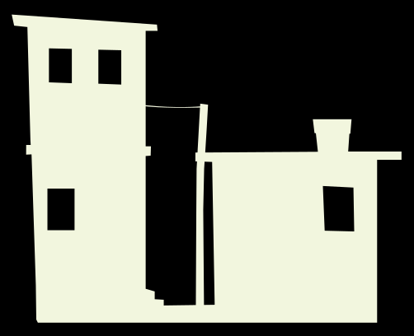

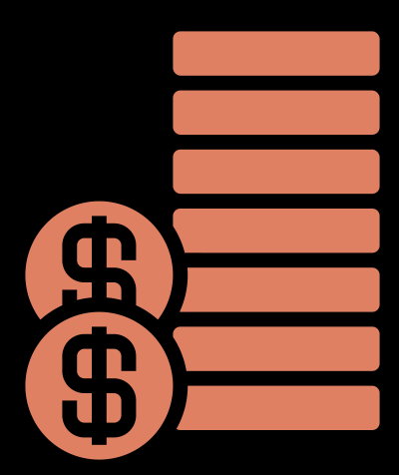
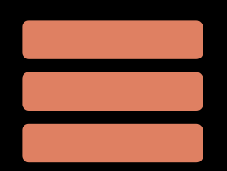
HOW WE FORCE THE POOR TO PAY MORE
Anyone who has ever struggled with poverty knows
how extremely expensive it is to be poor.
HOUSING
Renters in poor and predominantly Black neighborhoods pay more relative to property value.
HOUSING EXPLOITATION
When rental costs greatly exceed the property's value
Landlords in poor
areas make
12
10
% inadequate units:
8
Incomplete bathrooms
No running water
No electricity
double the
profit of those in
affluent ones.
6
$
4
2
$
0
Ref. 1
Extremely
Low Income
Very
Low Income
Low Income
All Higher
Incomes
Page 67
© Matthew Desmond, Poverty, by America

Slide 49






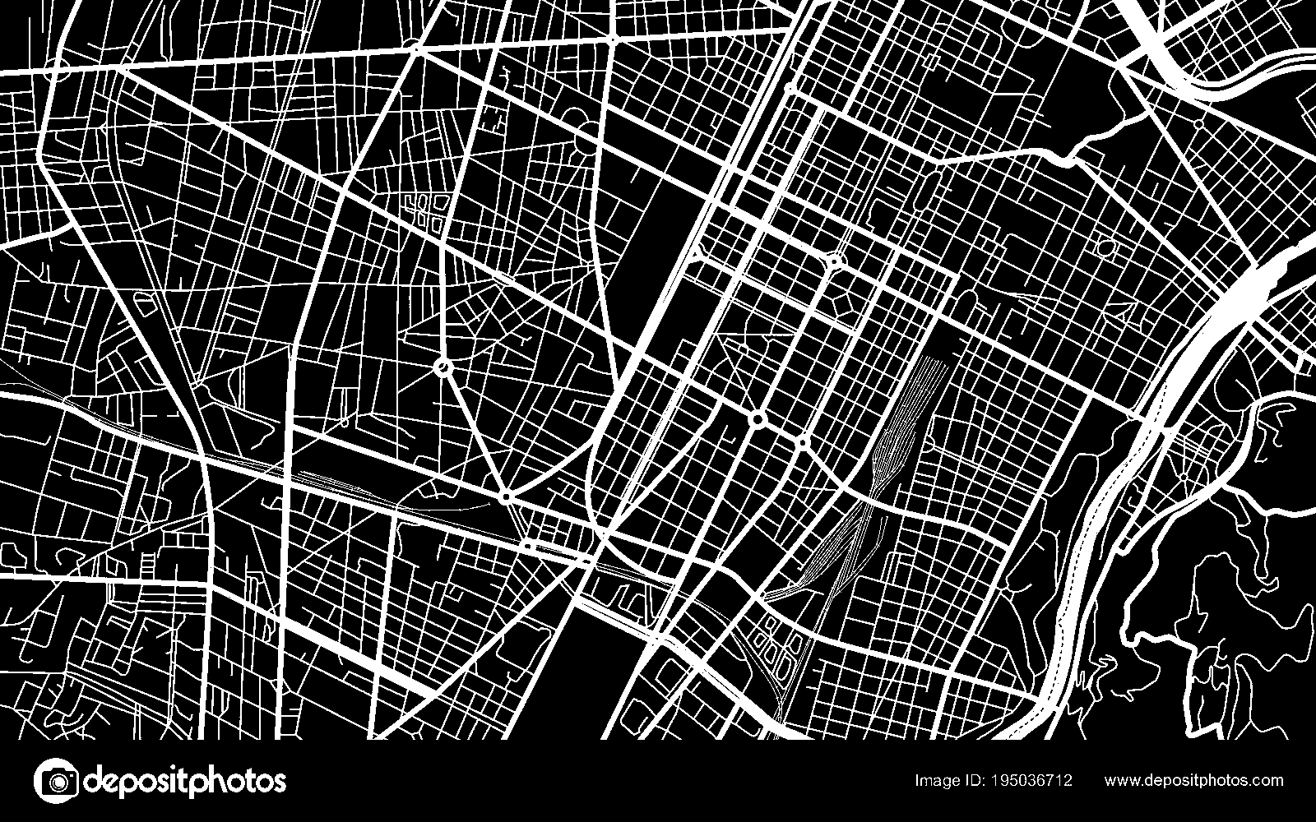
RIGGED RULES: EXPLOITING POOR FAMILIES IN HOUSING
EVICTION
FINANCIAL BARRIERS
DISCRIMINATION
Page 69
Some landlords use eviction
as a business strategy
Banks deny less profitable
small-dollar loans, creating “mortgage deserts.”
Research shows that in 50
years, there has been:
No decline in anti-Black
discrimination in mortgage cost
Mortgage
Cash or alternative financing
Little decline in anti-Black
discrimination in loan denial
The TOP 100 evicting buildings
account for 40% of evictions in
cities like Tucson, AZ, and
Fayetteville, NC.
Only 23% of homes under $100K
were financed with a mortgage.
Page 68
Page 70
© Matthew Desmond, Poverty, by America

Slide 50

HOW WE FORCE THE POOR TO PAY MORE
Anyone who has ever struggled with poverty knows
how extremely expensive it is to be poor.
FINANCE
Banks and predatory lenders levy high fees and unfavorable rates on those least able to afford them.
$61 MILLION in fees are collected from low-income Americans each day.
Page 77
© Matthew Desmond, Poverty, by America

Slide 51



THE HIGH PRICE OF LOW BALANCES
OVERDRAFT FEES
PAYDAY LENDING
CHECK CASHING
Page 71
Page 74
Page 72
Charges banks impose when an
account balance falls below zero
Short-term loans with high interest
rates that trap vulnerable borrowers
Services that charge unbanked people
high fees to process checks
Average customer’s income:
$30K
8%
6%
1%
Average fee:
$33.58
of Black
households
of Hispanic
households
of white
households
The average
borrower pays
$520 in fees
to borrow
$350…
Unbanked mostly due to minimum
balance requirements
…and remains
in debt for 5 MONTHS.
9%
of account holders with
an average balance of
LESS THAN $350 pay
Fees up to 10% of
the check’s value
$11 billion
each year
$9.8 billion
each year
$1.6 billion
each year
© Matthew Desmond, Poverty, by America

Slide 52
Reflect & Discuss
Chapter 4: How We Force the Poor to Pay More
Explore the psychological impact on a family making difficult housing choices under pressure.
How might such stress affect one's capacity for making 'sensible choices’?
1.
Analyze the role of credit scores in perpetuating poverty. How does this system disadvantage the
poor, and what alternative methods could be used to assess financial responsibility?
2.
Discuss the role of payday loan companies and the high fees associated with their services. How
do these practices trap people in poverty, and what can be done to offer fairer lending options?
3.
© Matthew Desmond, Poverty, by America

Slide 53
Reflect & Discuss
Chapter 4: How We Force the Poor to Pay More
Have you ever felt, like many, "forced to choose the best bad option"? How did that situation
come about, and what was the result?
4.
What's your reaction to the finding that landlords in poor neighborhoods make more profit than
those in richer areas?
5.
Have you ever wondered why people in impoverished areas don't just move to better places?
How does the provided context challenge or support your beliefs?
6.
Reflect on any personal biases or stereotypes you might hold about individuals who use services
like payday loans and check cashing. How can you challenge these biases?
7.
© Matthew Desmond, Poverty, by America

Slide 54
REFERENCES
Chapter 4
https://www.jchs.harvard.edu/blog/housing-inadequacy-remains-a-problem-for-the-lowest-income-renters
Select icons in this chapter are courtesy of The Noun Project.
© Matthew Desmond, Poverty, by America

Slide 55

Chapter 5:
How we rely on welfare
© Matthew Desmond, Poverty, by America

Slide 56





A TAX BREAK IS SOMETHING AKIN TO A GOVERNMENT CHECK
Tax breaks are the government's way of spending by not collecting.
TAX SUBSIDIES
WELFARE
Reductions in
owed tax amount
Government aid
for basic needs
Boost household income
Contribute to federal deficit
Target specific groups
Forgone federal revenue
Benefits skew toward the rich
Boosts household income
Contributes to federal deficit
Targets specific groups
Direct federal expenditures
Supports the poor
Page 98
© Matthew Desmond, Poverty, by America

Slide 57

A TAX BREAK IS SOMETHING AKIN TO A GOVERNMENT CHECK
We give the most to families who have plenty already,
and this starves antipoverty programs.
The United States spent
$1.8 TRILLION
on tax breaks in 2021.
The United States spent
$600 BILLION
on means-tested
benefits in 2021.
Page 93
© Matthew Desmond, Poverty, by America

Slide 58
529 PLANS: COLLEGE SAVINGS FOR THE RICH
A 529 plan is a tax-advantaged savings account for future education
expenses, offering tax-free growth and withdrawals.
COURSE NAME
INFO
SOC 529
Inequality Amplified
Through Rich Handouts
LOPSIDED BENEFITS
70% of benefits from 529 plans go to families
with more than $200K in household income.
Page 96
ECON 529
Fiscal Implications and
Government Costs
BILLIONS IN LOST REVENUE
Forgone federal revenue from 529 tax benefits expected to double to $4.1 billion by 2027.
Ref. 1
POL 529
The Dynamics of
Wealth and Policy
BACKLASH TO
POLICY REFORM
Obama swiftly withdrew a 2015 plan to tax 529
earnings after severe political backlash.
Page 96
© Matthew Desmond, Poverty, by America

Slide 59
WE HAVE A LOPSIDED WELFARE STATE
When it comes to government aid, the scales tip toward the rich.
Spending on means-
tested programs:
Total tax breaks
in 2021:
$1.8 TRILLION
$600 billion
Direct housing
assistance:
Homeowner
subsidies:
$193 BILLION
$53 BILLION
Lifetime limit on cash welfare:
Mortgage deductions:
Avg. 30-year term
5 years
© Matthew Desmond, Poverty, by America

Slide 60
WE HAVE A LOPSIDED WELFARE STATE
When it comes to government aid, the scales tip toward the rich.
$35,363
The richest American families receive almost 40% MORE in government
subsidies than the poorest.
$25,733
Page 99
Bottom
20%
Top
20%
© Matthew Desmond, Poverty, by America

Slide 61


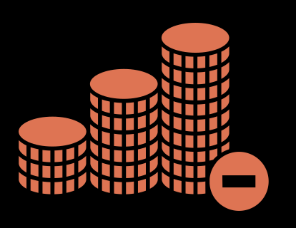
THE SUBTLE WAYS THAT AID FAVORS THE AFFLUENT
TAXING DISPARITY
PROGRAM VISIBILITY
The progressive federal tax is canceled out by other,
regressive taxes, leveling our overall tax rate.
A less ”visible“ tax break is fundamentally the same
as a government aid—both boost household income.
PROGRESSIVE TAX
A tax rate that increases as taxable income increases
Public housing
Food stamps
Cash welfare
Mortgage interest
deductions
529 Saving Plans
Employer-sponsored
healthcare
Sales taxes consume a
larger percentage of poor
families’ limited income
compared to the wealthy.
REGRESSIVE TAX
Taxes that force the
poor to pay a larger
share of their earnings
More delayed and opaque forms of government aid tend
to exclude the poor while substantially aiding the wealthy,
who can capitalize on them due to higher tax obligations.
Capital gains are taxed
at a lower rate than wages.
Page 94
Page 91
© Matthew Desmond, Poverty, by America

Slide 62




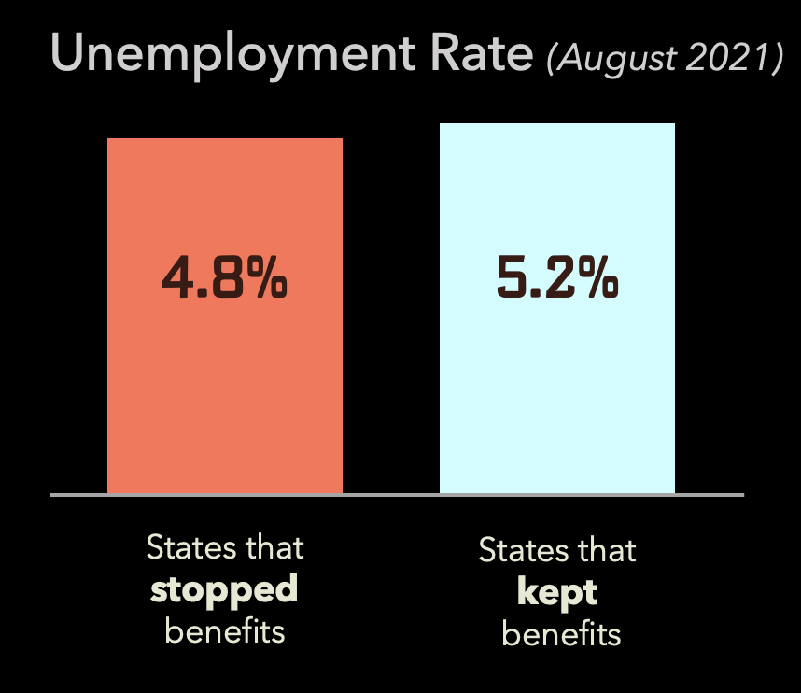
SETTING WELFARE MISCONCEPTIONS STRAIGHT
M
M
Y
Y
T
T
*
*
H
H
*
*
WELFARE ENCOURAGES UNEMPLOYMENT?
THE MIDDLE-CLASS PAYS THE PRICE?
M
M
Y
Y
T
T
Page 98
*
*
H
H
*
*
Employment didn’t rise after COVID-19 aid cuts
$
The average middle-class family receives
$7,100 MORE
in government aid than it pays in federal taxes.
Page 82
© Matthew Desmond, Poverty, by America

Slide 63










SETTING WELFARE MISCONCEPTIONS STRAIGHT
M
M
Y
Y
T
T
*
*
H
H
*
*
WELFARE BREEDS DEPENDENCE?
Welfare recipients
waste money?
Page 89
Page 87
M
Y
T
*
H
M
Y
T
*
*
H
*
Poor families pass over billions in aid each year.
Families receiving means-tested
government assistance spend a
larger share of their income on…
Earned Income Tax Credit (EITC)
Tax relief for low-income workers
$17.3 Billion
$13.4 Billion
Food Stamps
$62.2 Billion
Government Health Insurance
$9.9 Billion
Unemployment Insurance
$38.9 Billion
Supplemental Security Income (SSI)
Aid for elderly and those with disabilities
…basic necessities than
other American families.
$142 Billion
Total aid left on the table
© Matthew Desmond, Poverty, by America

Slide 64
THE BRIEF EASING OF CHILD POVERTY
Government action transformed a potential poverty crisis into an unprecedented decline during the pandemic.
The expanded Child Tax Credit functions like guaranteed income for households with kids.
2020 - 2021
Jan 2022
The expanded Child Tax Credit,
unemployment assistance and stimulus
checks caused a 46% DECREASE in child
poverty in 6 months.
17%
The end of monthly
payments caused a
41% INCREASE in child
poverty in 1 month.
12.1%
CHILD POVERTY RATE:
Dec 2021
Monthly expanded Child
Tax Credit payments end
5.2%
Ref. 2
© Matthew Desmond, Poverty, by America

Slide 65
THE BRIEF EASING OF CHILD POVERTY
From lagging among the world's poorest in addressing child poverty, pandemic-era policies
catapulted the U.S. to rank alongside the world's richest in reducing child poverty.
% reduction in relative child poverty rates due to taxes and income transfers in the U.S. vs. other countries
0
-1
-2
-3
-4
-5
United States 2019
-6
-7
-8
Poor Countries
United States 2021
Wealthy Countries
Ref. 3
© Matthew Desmond, Poverty, by America

Slide 66


WEALTHFARE
WELFARE
Our tax policies default to favoring the wealthy.
How we collect taxes and give benefits matters. Flip
the delivery system to prioritize the most vulnerable.
Taxes should hurt.
Corporate lobbyists and many lawmakers prefer
to keep tax filing costly and painful.
File taxes automatically, ensuring citizens pay
what they owe and receive benefits owed to
them.
Payroll taxes take a larger percentage from
low-income workers' earnings.
Automatically cut payroll taxes for low-income
workers.
Instead of a one-time deduction, mail a monthly
check; make benefits for the wealthy an opt-in
choice.
Homeowners can deduct mortgage interest from
taxable income, reducing their tax liability.
© Matthew Desmond, Poverty, by America

Slide 67
Reflect & Discuss
Chapter 5: How We Rely on Welfare
Reflect on the idea that tax breaks are similar to government benefits. How does this challenge
your perception of government assistance? Have you ever considered homeowner subsidies,
student loans, and tax breaks as forms of welfare? Why or why not?
1.
Reflecting on the early days of the pandemic, how did you perceive the financial struggles
of others around you? Did it change your perspective on poverty and unemployment?
2.
How do you feel knowing that swift government action during the pandemic led to a significant
decrease in child poverty?
3.
© Matthew Desmond, Poverty, by America

Slide 68
Reflect & Discuss
Chapter 5: How We Rely on Welfare
Have you ever found yourself agreeing with the sentiment that generous unemployment benefits
could discourage people from working? Why or why not?
4.
Reflect on the concept of being dependent on the state vs. being dependent on employers. How
do you see the balance between these dependencies in your own life?
5.
Think about anecdotes or stories you've heard about people on welfare. How have these shaped
your beliefs, and how do they compare to the actual data presented?
6.
Reflect on the government programs or tax benefits you or your family have benefited from. How
do they compare to the benefits received by less and more privileged groups?
7.
© Matthew Desmond, Poverty, by America

Slide 69
REFERENCES
Chapter 5
Oliff, Phillip, Laura Pontari, and Rebecca Thiess. “Use of 529 Plans Rising—Along with Revenue Impact.” The Pew Charitable Trusts, October 8, 2018. https://www.pewtrusts.org/en/research-and-analysis/articles/2018/10/08/use-of-529-plans-rising-along-with-revenue-impact.
Zachary Parolin & Sophie Collyer & Megan Curran, 2022. "Absence of Monthly Child Tax Credit Leads to 3.7 Million More Children in Poverty in January 2022," Poverty and Social Policy Brief 20417, Center on Poverty and Social Policy, Columbia University.
Parolin, Zachary, and Stefano Filauro. “The United States’ Record-Low Child Poverty Rate In International and Historical Perspective: A Research Note.” Demography 60, no. 6 (November 15, 2023): 1665–73. https://doi.org/10.1215/00703370-11064017.
Select icons in this chapter are courtesy of The Noun Project.
© Matthew Desmond, Poverty, by America

Slide 70

Chapter 6:
HOW WE BUY OPPORTUNITY
© Matthew Desmond, Poverty, by America

Slide 71
HOW TAX POLICY HAS PADDED POCKETS
Economic Recovery
Tax Act of 1981
Economic Growth and Tax Relief Reconciliation Act of 2001
Jobs and Growth Tax Relief Reconciliation Act of 2003
Caused 70% cut in Dept.
of Housing and Urban Development funding
Estate tax phase-
out favored rich
Lowered taxes on dividends and
capital gains
Tax Cuts and Jobs Act of 2017
Tax Reform Act of 1986
Will reduce public investment by an
estimated $1.9
TRILLION by 2027
Lowered corporate and capital
gains tax rates, and halved
top individual tax rates
© Matthew Desmond, Poverty, by America

Slide 72


PUBLIC SERVICES’ SHRINKING SHARE
Private fortunes have outpaced the public purse, slowly choking public investments.
114%
Over the last 50 years:
Personal incomes are up 317%
Taxes have only increased 252%
Income increase
Montana
112%
Oregon
Page 107
Public
education
spending
increase
54%
Government spending as a
percentage of the economy:
37%
Page 108
22% 17.6%
3 decades
1995
2021
Page 108
© Matthew Desmond, Poverty, by America

Slide 73

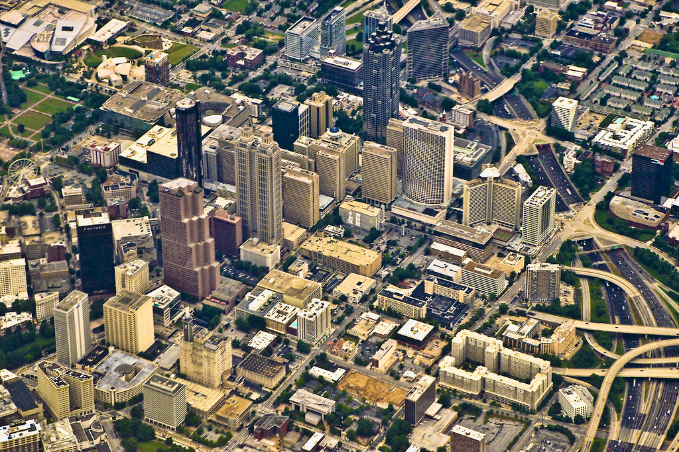
SHADES OF SUPPORT: RACE & PRIVATIZATION
In the wake of the civil rights era, white Americans began voting according
to their perceived racial interests rather than their economic ones.
WHITE
… in 2022,
of Atlanta’s population is
white
FLIGHT
38%
of Atlanta’s public school
students are white
When public schools were ordered to
integrate, white parents retreated into
private schools or decamped to the suburbs.
16%
Page 111
© Matthew Desmond, Poverty, by America

Slide 74
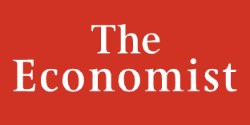
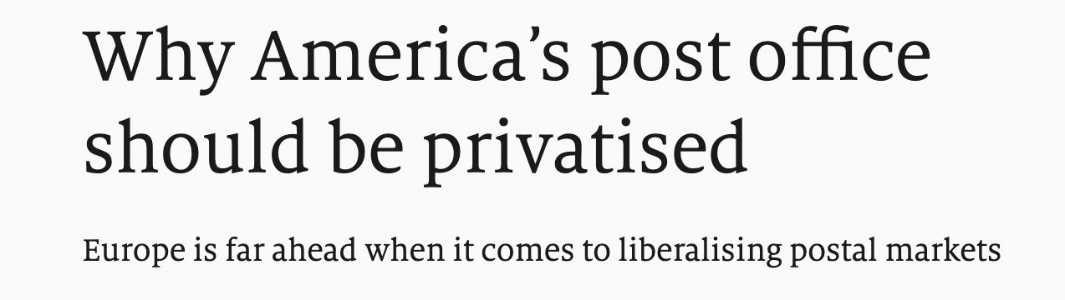

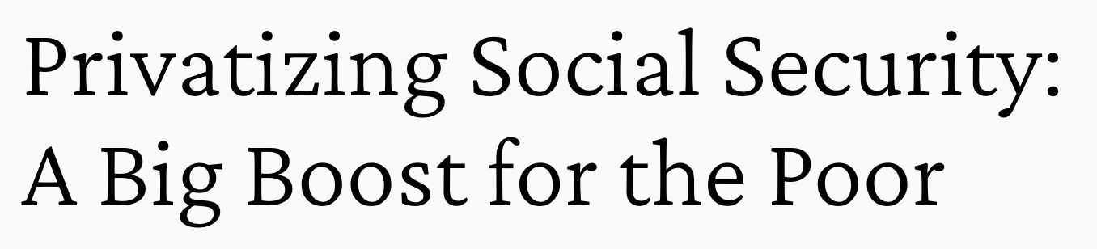

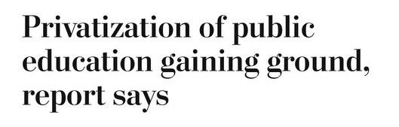
PRIVATE OPULENCE VS. PUBLIC SQUALOR
As the rich come to rely on private enterprises, they withdraw support from public institutions.
Disinvestment in
public institutions
Creation of
replacement private enterprises
© Matthew Desmond, Poverty, by America

Slide 75


ZONING LAWS BUILD WALLS WITHOUT BRICKS
$
Zoning laws govern what kinds of properties can be built in a community, controlling who gets in and who does not.
$
$
$
$
$
$
$
$
$
75%
12%
On roughly of residential land,
it is illegal to build anything except single-family detached houses.
Only of residential land in the
median large American city is permitted
for apartment dwellers.
Page 114
© Matthew Desmond, Poverty, by America

Slide 76
ZONING LAWS AS A MEANS OF SEGREGATION
The law does not prohibit class-based discrimination, which tends to harm
racial minorities more. This results in de facto racial discrimination.
Ref. 1
Page 114
How do such rules achieve segregation
even though explicit exclusion based on race is illegal?
Housing likely explains more
than 30% of the
Black-white racial wealth gap.
Racial zoning took the new name
of “density zoning” after the
1968 outlawing of segregation:
Minimum lot size requirements
Single residence per lot reqs.
Minimum square footage reqs.
Costly building codes
Building height limits
25.2%
“R-1 white district”
“R-2 colored district”
17.4%
7.5%
“R-1 dwelling
house district”
“R-2 apartment
house district”
White
Hisp.
Black
% living in high-poverty areas
Ref 2.
© Matthew Desmond, Poverty, by America

Slide 77




SUPPORT FOR A 12O—UNIT AFFORDABLE BUILDING
Perhaps we are not so polarized after all. Maybe above
a certain income level, we are all segregationists.
A survey found that conservative renters were more likely to support a proposal to build nearby
affordable housing than liberal homeowners.
2.58
2.68
Renters
Homeowners
Page 115
© Matthew Desmond, Poverty, by America

Slide 78
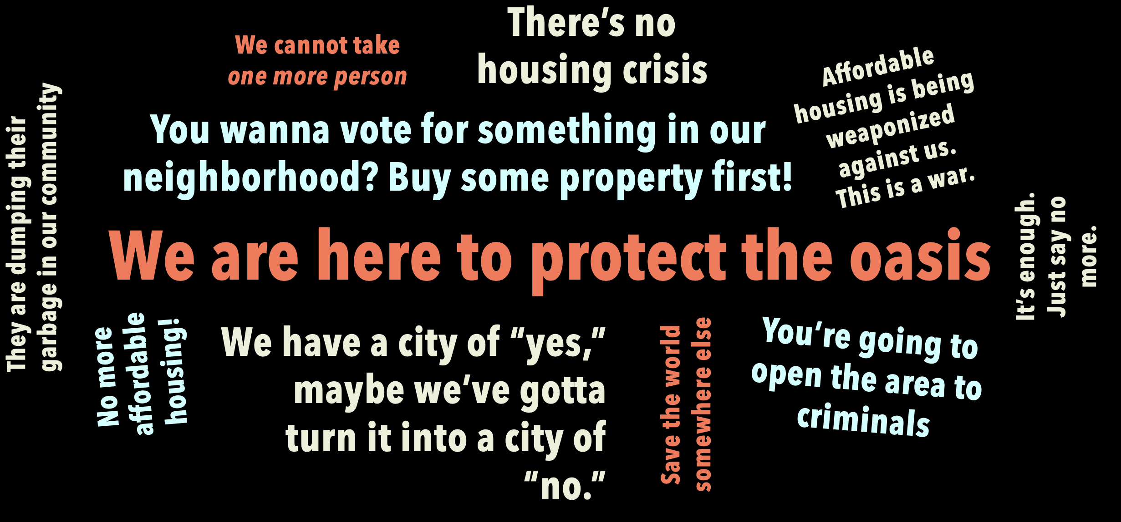
TAKE A PEEK INTO ZONING MEETINGS
Zoning meetings are public forums where officials and residents discuss land-use rules.
In affluent areas, they can be used to exclude lower-income individuals:
@WaluigiSoap: The quotes above are selections from hours of footage documenting zoning meetings across NYC.
© Matthew Desmond, Poverty, by America

Slide 79
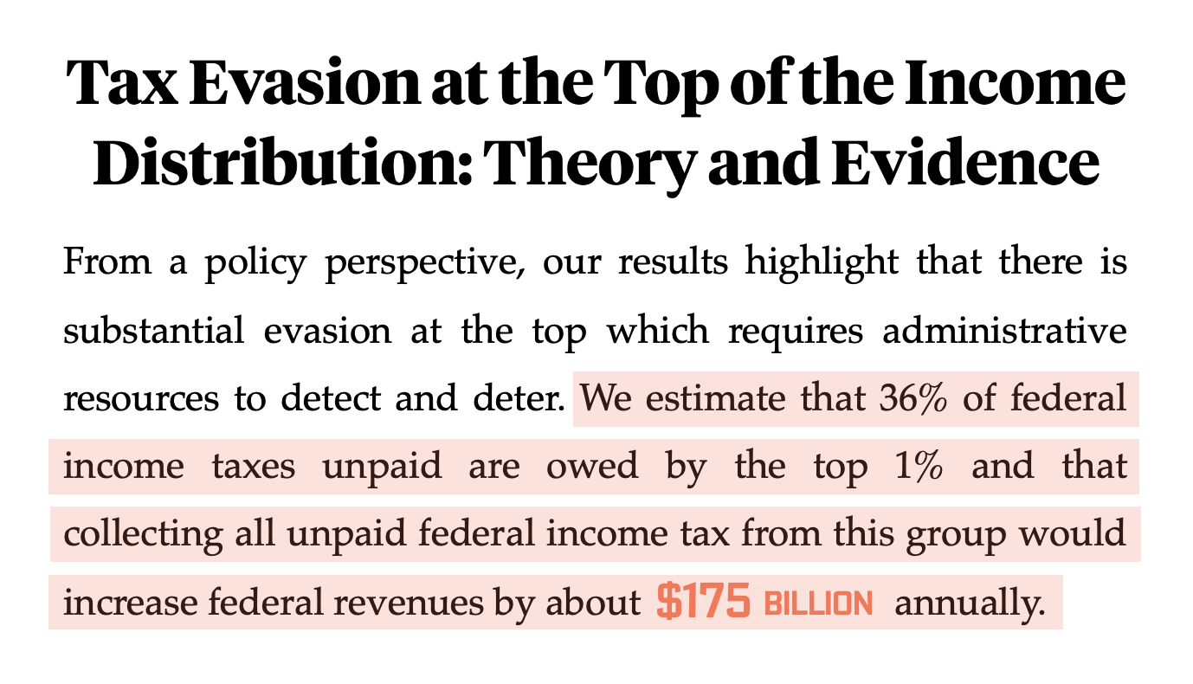






WE HAVE ENOUGH MONEY TO ABOLISH POVERTY
We have to stop spending so much on the rich.
This is what it is to be truly fiscally responsible.
$177 BILLION to lift everyone above the poverty line
$7K
$4K
Needs $10K
to come out of poverty
$11K
$15K
$18K
Page 124
© Matthew Desmond, Poverty, by America

Slide 80
Reflect & Discuss
Chapter 6: How We Buy Opportunity
Reflecting on the withdrawal of many white families from public spaces after the Civil Rights
legislation of the 1960s, in what ways might you or your community perpetuate divisions between
public and private spheres today?
1.
Why do you think the American middle and upper classes harbor a sentiment of "fret and worry"
despite their relative wealth?
2.
The concept of “private opulence and public squalor” suggests that the wealthy often disengage
from public services. Can you identify instances in your own life where you or your family might
have chosen private over public options? What were the motivations behind those choices?
3.
© Matthew Desmond, Poverty, by America

Slide 81
Reflect & Discuss
Chapter 6: How We Buy Opportunity
How do you reconcile wanting the best for your family (like good schools and neighborhoods) with
the broader need for socio-economic integration and opportunity for all?
4.
Poverty, by America suggests that "sharing opportunity does not mean that everyone wins."
Do you agree or disagree with this statement? How can society strive for more equitable distribution
of resources without diminishing opportunities for others?
5.
Reflect on the statement: “Those who have benefitted from the nation’s excesses will have to take
less so that others may share in the bounty.” In what ways can you make choices that better balance personal advantage with shared community prosperity?
6.
© Matthew Desmond, Poverty, by America

Slide 82
REFERENCES
Chapter 6
Demos. “The Racial Wealth Gap: Why Policy Matters | Demos,” n.d. https://www.demos.org/research/racial-wealth-gap-why-policy-matters.
Grimshaw, Abigail. “Understanding Exclusionary Zoning and Its Impact on Concentrated Poverty.” The Century Foundation, March 15, 2022. https://tcf.org/content/facts/understanding-exclusionary-zoning-impact-concentrated-poverty/?agreed=1.
Select icons in this chapter are courtesy of The Noun Project.
© Matthew Desmond, Poverty, by America

Slide 83

Chapter 7:
INVEST IN ENDING POVERTY
© Matthew Desmond, Poverty, by America

Slide 84






CONNECT FAMILIES TO THE AID FOR WHICH THEY QUALIFY
Evidence shows that confusing programs turn low-income Americans away.
Easy Applications
Application Assistance
100%
How can states improve
uptake rates?
Reduce text
Use readable fonts
Enroll automatically
Benefits specialists can
help fill out paperwork
and collect documents.
Roughly a third of Californians
who qualify for food stamps
don’t use them.
Outreach & Reminders
Reduce Asset Tests
Drive program
awareness via mailers, email, advertisements,
and phone calls.
Rigorous requirements
deter candidates from applying, fearing disqualification.
70%
Page 123
© Matthew Desmond, Poverty, by America

Slide 85






OUR UNSEEN ROLE IN EXPLOITATION
Homeowners benefit from
tax breaks and increasing
scarcity using zoning
restrictions.
Consumers demand
efficiency at any cost and
invest in an exploitative
stock market.
Bank account holders
enjoy free checking accounts subsidized by overdraft fees.
Landlords
Corporations
Check Cashers
Payday Lenders

Slide 86



HOLD A MIRROR TO YOUR INSTITUTIONS
Push for progress by confronting established practices at home.
Does your bank fund payday lenders?
Does it charge exorbitant overdraft fees?
Is your university adequately supporting first-
generation and underrepresented students?
Are staff being compensated fairly?
Is your campus contributing to gentrification?
Does your school have an endowment that funds exploitative corporations?
Does your employer institute unnecessary
barriers to entry?
Do they encourage unpaid labor?
© Matthew Desmond, Poverty, by America

Slide 87


MAKE PERMANENT INCREASES TO THE CHILD TAX CREDIT
This program led to a historic 46% poverty reduction without affecting employment.
The 2021 expanded Child Tax Credit, now expired, benefited many more
families, even those with very low incomes.
12.4%
9.7%
July – December 2021
5.2%
$ amount increased per child
Full credit even if no income
Payments monthly, not yearly
Higher phase-out thresholds
Low family income left 27 million kids
without full Child Tax Credit benefits
before 2021, and it's happening again.
2020
2021
2022
Annual SPM Child Poverty Rate
Ref. 1
Ref. 2
© Matthew Desmond, Poverty, by America

Slide 88



PROVIDE MORE RENTAL ASSISTANCE
Rental assistance helps low-income families with housing
while tax breaks further enrich already wealthy homeowners.
MORTGAGE
INTEREST DEDUCTIONS:
$30 BILLION
EMERGENCY RENTAL ASSISTANCE: $46 BILLION
A federal initiative to help low-income renters avoid eviction during COVID-19
Page 101
Renters that received rental assistance reported:
Only 0.01% of savings
reach the poorest; over
50% benefit the wealthy.
Better mental
health
Less rental
debt
More access to
healthcare
$20k annual
family income
< $200k annual
family income
Ref. 3
© Matthew Desmond, Poverty, by America

Slide 89
FIX OUR MISSHAPEN SAFETY NET
There are countless ways to deepen our investments in economic opportunity and safety.
25%
Raise $30 BILLION by winding
down the mortgage interest deduction.
Collect the
in unpaid federal income taxes owed by the top 1%.
Mandate a profit
tax regardless of the
country a U.S. company is registered in.
$175 BILLION
Raise $64.7 BILLION by increasing the
max. earnings taxable for Social Security.
Fund the IRS to track down
unpaid federal income
taxes totaling
Bump the top marginal
tax rate back up.
Raise $37.3 BILLION by taxing capital
gains and dividends the same as income.
70%
$1 TRILLION.
37%
1975
2023
© Matthew Desmond, Poverty, by America
Page 128

Slide 90

REFLECT & DISCUSS
Chapter 7: Invest in Ending Poverty
What role do you think shame and public perception play in the reluctance of individuals to claim benefits? How can society combat the stigma attached to these aids?
1.
The chapter provides a dollar amount of $177 billion to abolish poverty. Do you think that simply throwing money at the issue is the solution, or are there deeper, systemic changes needed to truly address poverty?
2.
This chapter suggests several of solutions to raise funds for eradicating poverty. Which solutions resonate with you, and why? Are there any you disagree with?
3.
© Matthew Desmond, Poverty, by America

Slide 91

REFLECT & DISCUSS
Chapter 7: Invest in Ending Poverty
Reflecting on the government's response during the COVID-19 pandemic, do you believe that the measures taken to alleviate poverty were sufficient?
4.
What do you think about programs like Emergency Rental Assistance and the Expanded Child Tax Credit?
5.
Think of recent movies and TV shows like Parasite, Chef, White Lotus, and Succession. What
insights do they offer about inequality? Can you think of other media that shed light on the topic
of poverty and our role in perpetuating it?
6.
© Matthew Desmond, Poverty, by America

Slide 92
REFERENCES
Chapter 7
“Year-End Tax Policy Priority: Expand the Child Tax Credit for the 19 Million Children Who Receive Less than the Full Credit.” Center on Budget and Policy Priorities, December 7, 2022. https://www.cbpp.org/research/federal-tax/year-end-tax-policy-priority-expand-the-child-tax-credit-for-the-19-million#_ftnref1.
US Census Bureau. “Income, Poverty and Health Insurance Coverage in the United States: 2022.” Census.gov, September 26, 2023. https://www.census.gov/newsroom/press-releases/2023/income-poverty-health-insurance-coverage.html#:~:text=The%20SPM%20child%20poverty%20rate,people%20out%20of%20SPM%20poverty.
https://nlihc.org/sites/default/files/beyond-housing-stability.pdf
Select icons in this chapter are courtesy of The Noun Project.
© Matthew Desmond, Poverty, by America

Slide 93

Chapter 8:
EMPOWER THE POOR
© Matthew Desmond, Poverty, by America

Slide 94




WHAT CAN WE DO TO FIGHT WORKER EXPLOITATION?
POLICY
PERSONALLY
In 80+ countries, laws mandate
periodic review of minimum wages,
usually annually or biennially.
Boycott businesses that have unfair labor practices. These resources can help:
Page 139
bcorporation.net
donegood.co
betterworldshopper.org
In approximately 100 countries, the
central government sets minimum wages after
worker and employer groups are consulted.
Examine your university's endowment
and speak out against investments in exploitative companies.
Page 140
$
Strengthen worker protections by regulating
anti-union consultants and limiting
corporate lobbying.
Vote for representatives who stand
for labor rights.
© Matthew Desmond, Poverty, by America

Slide 95




WHAT CAN WE DO TO FIGHT WORKER EXPLOITATION?
SECTORAL BARGAINING: Uniting Industries for Fair Wages
Workers across an
industry elect representatives
Reps negotiate with employers and
government
Parties agree on
wages, hours, and
benefits
Agreement gets periodic review
Ensures a
democratic voice
Multi-stakeholder
input yields fair,
stable agreements
Standardizes fair
worker treatment
industry-wide
Ensures terms
evolve with
market shifts
Page 142
© Matthew Desmond, Poverty, by America

Slide 96



WHAT CAN WE DO TO FIGHT WORKER EXPLOITATION?
SECTORAL BARGAINING: Uniting Industries for Fair Wages
U.S. unions typically negotiate with single employers rather than
sectors, though sectoral bargaining exists in some industries.
Building and Construction
Trades Council
United Mine Workers of America
International Brotherhood of Teamsters
BCTC unions, like the United Brotherhood of Carpenters and
Joiners, negotiate wage and
work standards with employers.
Sets sector-wide wage and work standards with coal industry associations, impacting many
mining companies
Sets employment terms for
almost the entire trucking
industry through the National Master Freight Agreement
© Matthew Desmond, Poverty, by America

Slide 97
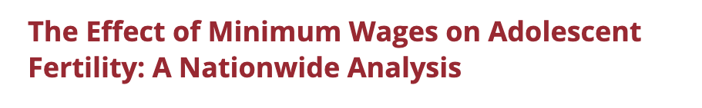
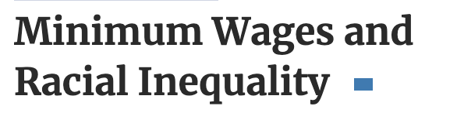
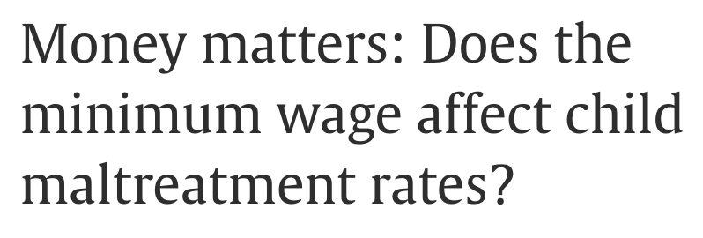
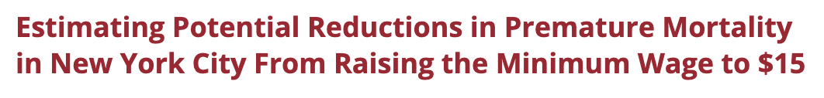
WHAT HAPPENS WHEN WE RAISE THE MINIMUM WAGE?
Higher wages dramatically improve health and well-being.
A $1 minimum wage hike could cut
yearly adolescent births by 5,000.
Improved minimum wage policy
reduces racial income disparities.
A higher minimum wage could have prevented 2,800 to
5,500 early NYC deaths, or 4-8% of the total.
Increasing the minimum wage leads
to fewer child maltreatment reports.
© Matthew Desmond, Poverty, by America
Refs. 1-4

Slide 98





BREAK THE CYCLE OF FINANCIAL DECEIT
LEND FAIRLY
END OVERDRAFT FEES
16 states prohibit payday loans
or cap interest rates, saving
their low-income residents
$3.5 BILLION annually.
ALTERNATIVES
Decline transactions
Allow grace periods
Offer small-dollar, 1% interest loans
Page 150
EXPAND ACCESS TO GOOD CREDIT
In the United Kingdom,
overdraft fees are 1/10TH of
what they are in the
United States.
The USPS or Federal Reserve could
issue low-interest, small-dollar loans.
Page 149
© Matthew Desmond, Poverty, by America

Slide 99






HOW CAN WE LEVEL THE LIVING FIELD?
FINANCE FAIRLY
COMMONING
Page 146
Guarantee mortgages to low-income families.
Housing emphasizing community input,
collective decisions, and shared ownership
The 502 Direct Loan Program for low-income
families in rural areas has moved over
2 MILLION families into their own homes.
STABILITY
AFFORDABILITY
SUPPORT
No unfair rent
hikes or eviction
threats
Units often at
below-market
rates
Resource pooling
trims individual
expenses
Page 145
For lowest income levels, can cover
the down payment
Low interest rates
Includes eligibility for loans and
grants to help with repairs
© Matthew Desmond, Poverty, by America

Slide 100

REFLECT & DISCUSS
Chapter 8: Empower the Poor
What does empowerment mean to you, and how can society actively work to empower those
living in poverty?
1.
What is your stance on the regulation of banks and payday loan companies? Have you or
someone you know ever relied on such financial services? How might that experience inform your
views on the need for reforms? What alternative credit systems can be established to help those in
need without plunging them further into debt?
2.
Can you think of a time when collective negotiation would have benefited you or someone you
know in the workplace? How would sectoral bargaining have potentially changed that situation?
3.
© Matthew Desmond, Poverty, by America

Slide 101

REFLECT & DISCUSS
Chapter 8: Empower the Poor
Reflect on your personal boundaries and limits when it comes to paying more for ethically
produced goods and services. How do you prioritize your values in your consumption choices?
4.
Why do you think the sub-minimum wage for certain workers, like servers, persists in some areas
despite criticisms? What do you foresee as potential challenges or benefits to scrapping the sub-minimum wage and increasing the federal minimum wage?
5.
How does the "commoning" model challenge traditional concepts of property and housing? What
are the potential benefits and drawbacks of such a model based on the examples provided?
6.
© Matthew Desmond, Poverty, by America

Slide 102
REFERENCES
Chapter 8
Bullinger, Lindsey Rose. “The Effect of Minimum Wages on Adolescent Fertility: A Nationwide Analysis.” American Journal of Public Health 107, no. 3 (March 1, 2017): 447–52. https://doi.org/10.2105/ajph.2016.303604.
Derenoncourt, Ellora, and Claire Montialoux. “Minimum Wages and Racial Inequality*.” The Quarterly Journal of Economics 136, no. 1 (September 14, 2020): 169–228. https://doi.org/10.1093/qje/qjaa031.
Tsao, Tsu-Yu, Kevin J. Konty, Gretchen Van Wye, Oxiris Barbot, James L. Hadler, Natalia Linos, and Mary T. Bassett. “Estimating Potential Reductions in Premature Mortality in New York City from Raising the Minimum Wage to $15.” American Journal of Public Health 106, no. 6 (June 1, 2016): 1036–41. https://doi.org/10.2105/ajph.2016.303188.
Select icons in this chapter are courtesy of The Noun Project.
© Matthew Desmond, Poverty, by America

Slide 103

Chapter 9:
TEAR DOWN THE WALLS
© Matthew Desmond, Poverty, by America

Slide 104



END EXCLUSIONARY ZONING
While exclusionary zoning makes it illegal to develop affordable housing, inclusionary zoning makes it illegal not to.
Tax relief for developers that include affordable housing in their blueprints
Cut off federal funding to jurisdictions
with exclusionary zoning.
Density bonuses: Permit extra development volume in exchange
for affordable unit allocation.
Lower property taxes and
fund public services in
communities that welcome
low-income families.
This idea came from Republican Senator George Romney as the 1970
Department of Housing and Urban Development Secretary under Nixon.
Page 168
© Matthew Desmond, Poverty, by America

Slide 105





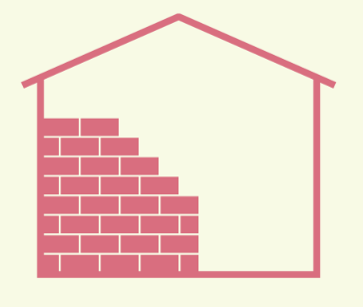











END EXCLUSIONARY ZONING
New Jersey is leading the way by mandating inclusionary housing.
The NJ Supreme Court
has prohibited
exclusionary zoning.
340 towns have broken ground
on thousands of affordable
housing developments.
All municipalities are
required to provide their
“fair share” of affordable housing.
Developers bid eagerly on
more profitable multifamily complexes, requiring no
state or federal funding.
If they fail to do so, the
courts can make them by redrawing zoning lines.
NJ property values remain
among the highest in the
nation and schools rank first.
© Matthew Desmond, Poverty, by America
Page 166

Slide 106

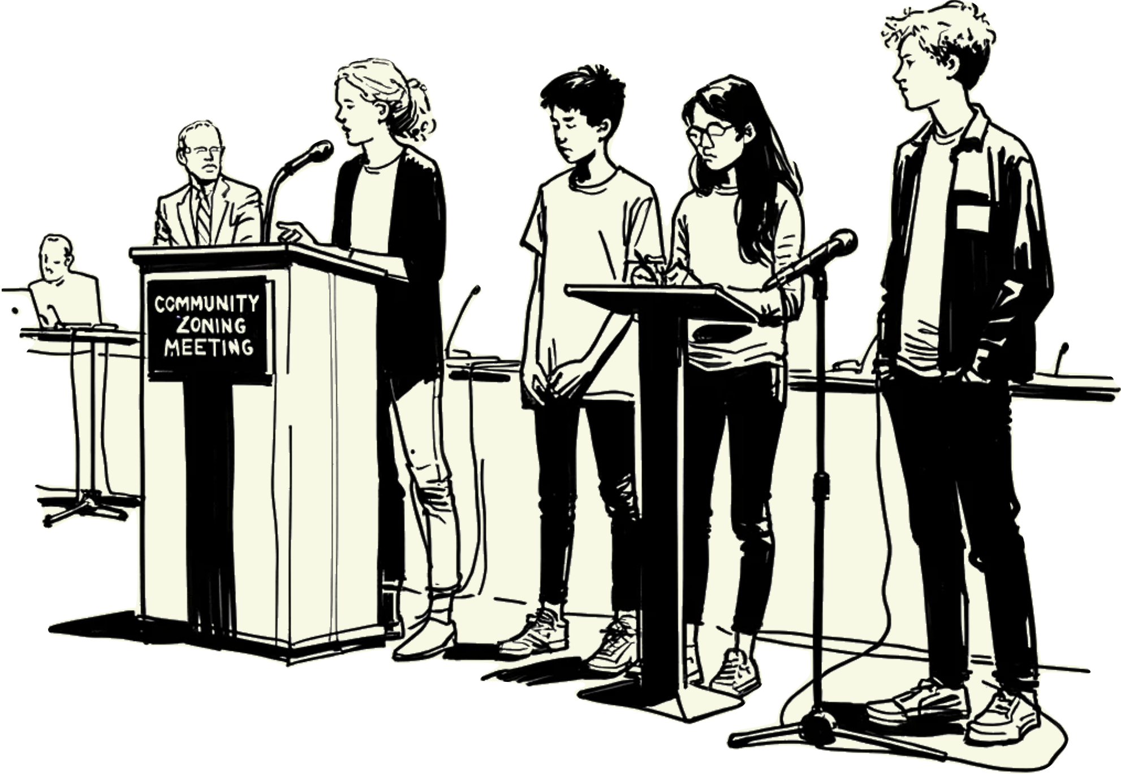
SPEAK UP AT PUBLIC FORUMS
Opposing segregation is essential to poverty abolitionism.
The voices of young people eager to embrace
diversity in their schools and support affordable
housing are vital in zoning meetings.
© Matthew Desmond, Poverty, by America

Slide 107
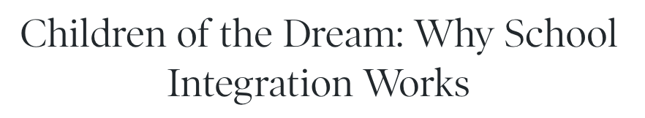
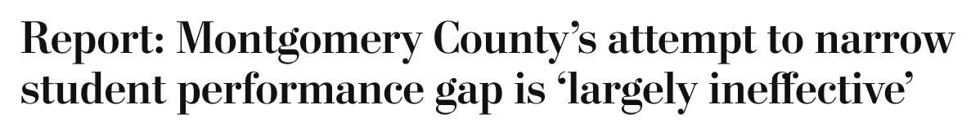
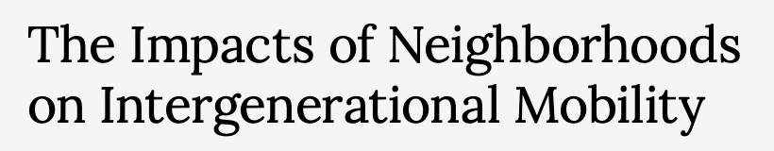
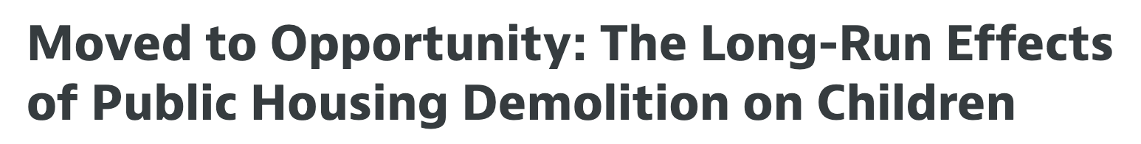
THE IMPACT OF INCLUSIVE EDUCATION AND HOUSING
By deconcentrating poverty in schools and communities, integration blunts its sting.
Long-term studies since the 1960s
show well-funded, integrated schools
boost student success.
Students from poor families at low-poverty schools
outperformed peers at well-funded high-poverty schools.
Areas with higher rates of upward
mobility tend to have less segregation
by income and race.
Low-income students who relocate to less disadvantaged neighborhoods earn more, have
lower dropout rates, and fewer arrests.
© Matthew Desmond, Poverty, by America
Refs. 1-4

Slide 108

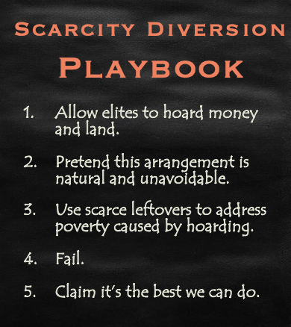
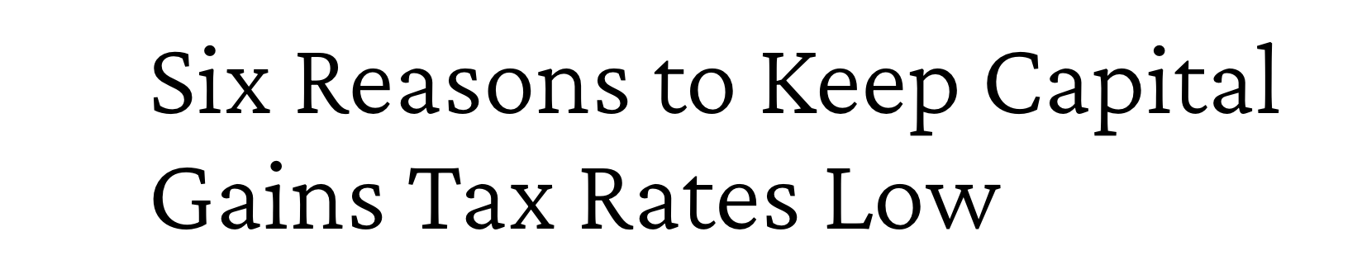
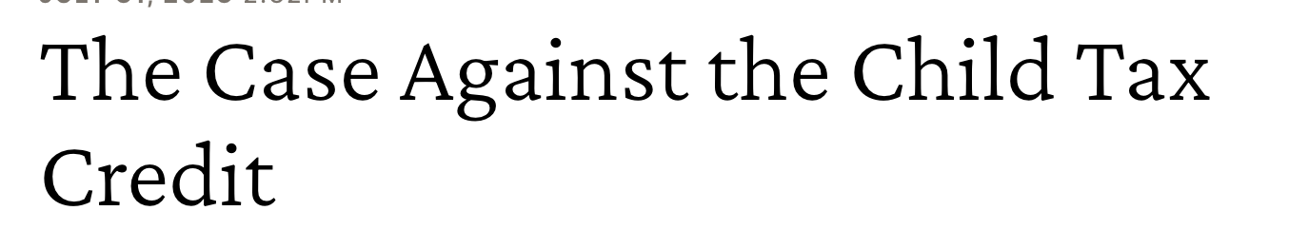
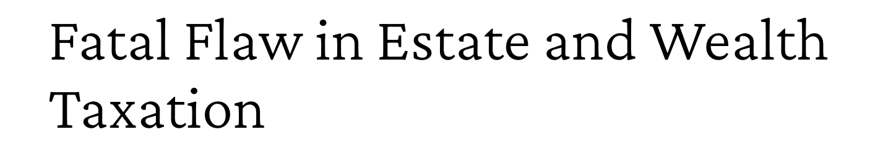

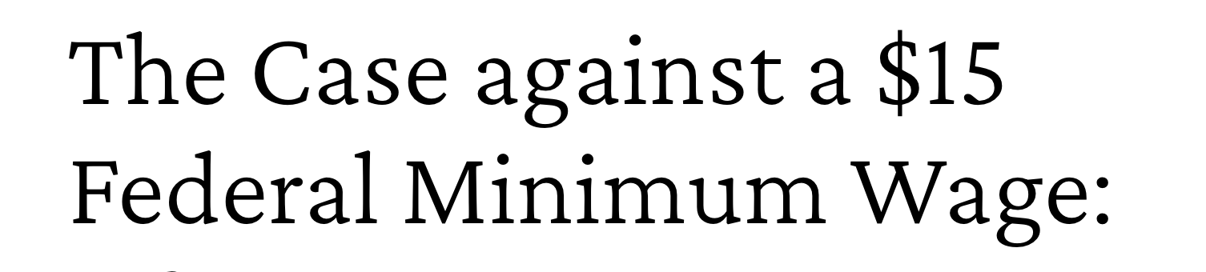
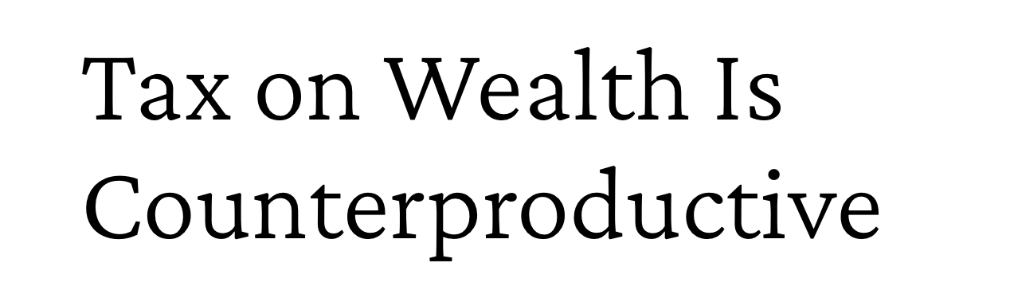
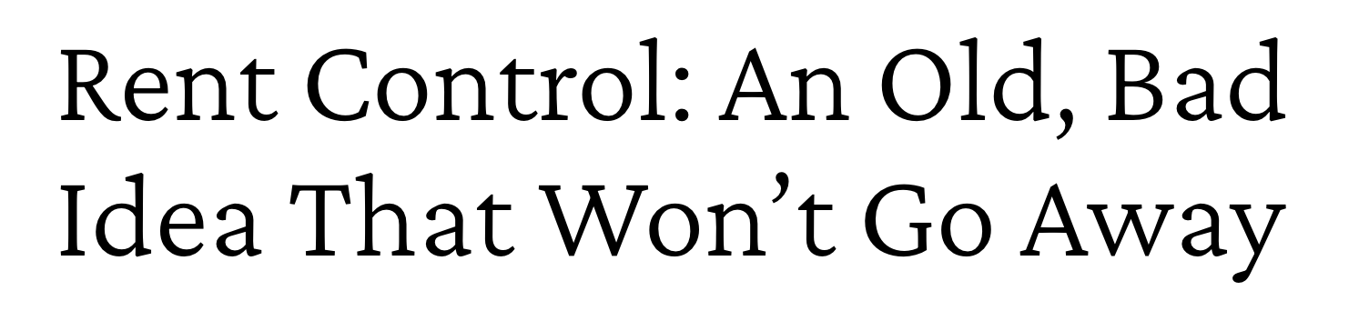
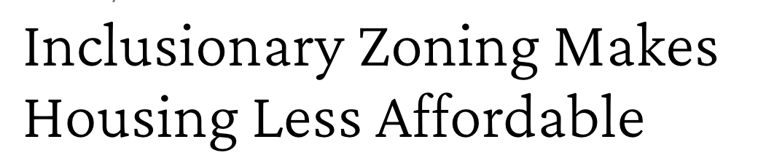
RECOGNIZE SCARCITY DIVERSION TACTICS
Manufactured scarcity empowers and justifies racism.
Page 174
HOARD
DENY
Refs. 5-12
© Matthew Desmond, Poverty, by America

Slide 109

REFLECT & DISCUSS
Chapter 9: Tear Down the Walls
Think about the neighborhood you grew up in. How economically and racially diverse was it, and
how might that have influenced your early perceptions of poverty and affluence?
1.
Given the evidence about the benefits of moving poor families to better neighborhoods, how
might the simple act of relocation address systemic issues of poverty?
2.
Poverty, by America argues that affluent families may need to make sacrifices to end segregation.
What might these sacrifices look like, and how can we cultivate a more collective sense of
responsibility?
3.
© Matthew Desmond, Poverty, by America

Slide 110
REFLECT & DISCUSS
Chapter 9: Tear Down the Walls
Have you ever considered how zoning and housing policies in your own community might affect
who gets to live there and who doesn’t? If you were in a position to decide, would you support inclusionary housing policies like New Jersey's in your neighborhood?
4.
Public housing has both negative and positive examples. Is there public housing in your
community? What is its reputation?
5.
Imagine you're a developer tasked with integrating affordable housing units into a luxury project
due to mandated housing policies like those in New Jersey. How would you approach potential resistance from prospective wealthier buyers, and what would you say to ease their concerns?
6.
© Matthew Desmond, Poverty, by America

Slide 111
REFLECT & DISCUSS
Chapter 9: Tear Down the Walls
How did the infrastructure and resources of your childhood community (schools, parks, libraries) compare to others’? Do you think you had more or fewer opportunities based on the neighborhood's socioeconomic status?
7.
How has your childhood neighborhood evolved over the years? Are there more walls or barriers now, or have some been dismantled? How do you feel about those changes?
8.
Were you exposed to families from various economic backgrounds where you grew up? How did this exposure (or lack thereof) influence your understanding and interactions with people from different socioeconomic backgrounds now?
9.
© Matthew Desmond, Poverty, by America

Slide 112
REFERENCES
Chapter 9
Johnson, Rucker C., and Alexander Nazaryan. Children of the Dream: Why School Integration Works. Basic Books, 2019.
Lumpkin, Lauren. “Report: Montgomery County’s Attempt to Narrow Student Performance Gap Is ‘Largely Ineffective.’” Washington Post, December 30, 2019. https://www.washingtonpost.com/local/education/report-montgomery-countys-attempt-to-narrow-student-performance-gap-is-largely-ineffective/2019/12/30/eec8729e-227e-11ea-bed5-880264cc91a9_story.html.
Chetty, Raj, and Nathaniel Hendren. “The Impacts of Neighborhoods on Intergenerational Mobility I: Childhood Exposure Effects,” December 1, 2016. https://doi.org/10.3386/w23001.
Chyn, Eric. “Moved to Opportunity: The Long-Run Effects of Public Housing Demolition on Children.” The American Economic Review 108, no. 10 (October 1, 2018): 3028–56. https://doi.org/10.1257/aer.20161352.
cato.org. “Six Reasons to Keep Capital Gains Tax Rates Low.” December 28, 2012. https://www.cato.org/commentary/six-reasons-keep-capital-gains-tax-rates-low#:~:text=Aside%20from%20increasing%20realizations%2C%20capital,for%20all%20workers%20over%20time.
© Matthew Desmond, Poverty, by America

Slide 113
REFERENCES
Chapter 9
.
.
.
.
.
cato.org. “Fatal Flaw in Estate and Wealth Taxation,” May 4, 2021. https://www.cato.org/blog/fatal-flaw-estate-wealth-taxation.
cato.org. “Tax on Wealth Is Counterproductive,” October 1, 2019. https://www.cato.org/commentary/tax-wealth-counterproductive.
cato.org. “The Case Against the Child Tax Credit,” July 31, 2023. https://www.cato.org/blog/case-against-child-tax-credit.
cato.org. “Cut the Earned Income Tax Credit,” November 29, 2022. https://www.cato.org/blog/cut-earned-income-tax-credit.
cato.org. “The Case against a $15 Federal Minimum Wage: Q&A,” February 25, 2021. https://www.cato.org/commentary/case-against-15-federal-minimum-wage-qa.
cato.org. “Rent Control: An Old, Bad Idea That Won’t Go Away,” November 5, 2018. https://www.cato.org/commentary/rent-control-old-bad-idea-wont-go-away#:~:text=Landlords%20under%20rent%20control%20have,the%20rent%E2%80%90%E2%80%8Bcontrolled%20price.
The Independent Institute. “Inclusionary Zoning Makes Housing Less Affordable | Edward P. Stringham,” n.d. https://www.independent.org/news/article.asp?id=1416.
Select icons in this chapter are courtesy of The Noun Project.
© Matthew Desmond, Poverty, by America

Slide 114






become a poverty abolitionist
Withdraw support from corporations that exploit
their workers.
Conduct a poverty
audit, examining the
ways you are connected
to the problem—and the
solution.
Welcome
affordable
housing
developments in
your community.
Reject a scarcity mindset
and recognize the nation’s
bounty.
Support policies
that disrupt poverty instead of ones that accommodate it.
Join an antipoverty organization working to eliminate poverty.
© Matthew Desmond, Poverty, by America
the poor by reining in exploitation
communities to promote broad prosperity

Slide 115
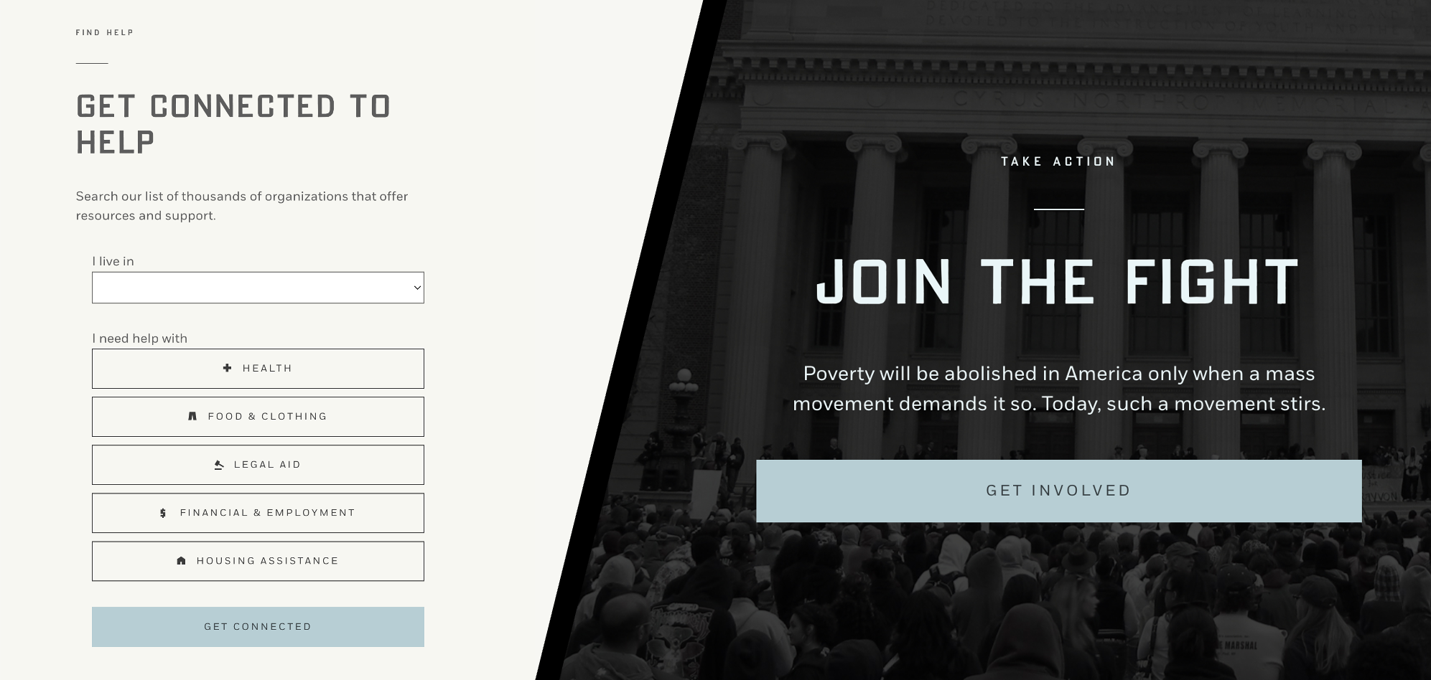
Search for antipoverty organizations in your area & nationwide.
EndPovertyusa.org
communities to promote broad prosperity

Slide 116
Poverty isn't a LINE. It's a TIGHT KNOT of social maladies.
© Matthew Desmond, Poverty, by America
in families by rebalancing the safety net
the poor by reining in exploitation
communities to promote broad prosperity

Slide 117
Poverty isn't a LINE. It's a TIGHT KNOT of social maladies.
INVEST
in families by rebalancing the
safety net.
© Matthew Desmond, Poverty, by America
in families by rebalancing the safety net
the poor by reining in exploitation
communities to promote broad prosperity

Slide 118
Poverty isn't a LINE. It's a TIGHT KNOT of social maladies.
INVEST
EMPOWER
in families by rebalancing the
safety net.
the poor by reining
in exploitation.
© Matthew Desmond, Poverty, by America
in families by rebalancing the safety net
the poor by reining in exploitation
communities to promote broad prosperity

Slide 119
Poverty isn't a LINE. It's a TIGHT KNOT of social maladies.
INVEST
EMPOWER
in families by rebalancing the
safety net.
the poor by reining
in exploitation.
BUILD
inclusive and open communities.
© Matthew Desmond, Poverty, by America
in families by rebalancing the safety net
the poor by reining in exploitation
communities to promote broad prosperity

